Slide 1

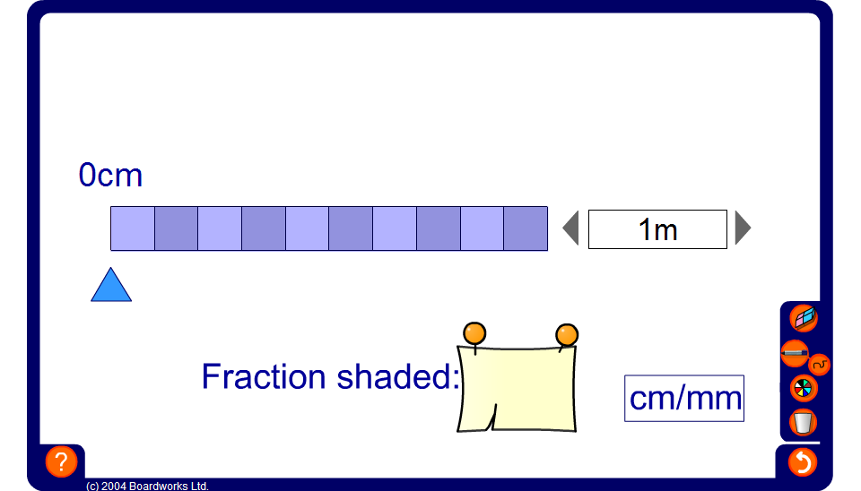


Fractions of distances
Notes:
Use this tool to ask pupils for fractions of distances given in metres.
For example, set the total distance to 1 metre.
Drag the slider to 40 cm and ask pupils:
What fraction of one metre is 40 cm?
Explain that to write one distance as a fraction of another we must convert them to the same units.

